Slide 1
UNIT 3
8086mp

Slide 2
The 8086 microprocessor is an 8-bit/16-bit microprocessor designed by Intel in the late 1970s. It is the first member of the x86 family of microprocessors, which includes many popular CPUs used in personal computers.
The architecture of the 8086 microprocessor is based on a complex instruction set computer (CISC) architecture, which means that it supports a wide range of instructions, many of which can perform multiple operations in a single instruction.
The 8086 microprocessor has a 20-bit address bus, which can address up to 1 MB of memory, and a 16-bit data bus, which can transfer data between the microprocessor and memory or I/O devices.
The 8086 microprocessor has a segmented memory architecture, which means that memory is divided into segments that are addressed using both a segment register and an offset.

Slide 3
The segment register points to the start of a segment, while the offset specifies the location of a specific byte within the segment.
This allows the 8086 microprocessor to access large amounts of memory, while still using a 16-bit data bus.
The 8086 microprocessor has two main execution units: the execution unit (EU) and the bus interface unit (BIU).
The BIU is responsible for fetching instructions from memory and decoding them, while the EU executes the instructions.
The BIU also manages data transfer between the microprocessor and memory or I/O devices.

Slide 4
The 8086 microprocessor has a rich set of registers, including general-purpose registers, segment registers, and special registers.
The general-purpose registers can be used to store data and perform arithmetic and logical operations, while the segment registers are used to address memory segments.
The special registers include the flags register, which stores status information about the result of the previous operation, and the instruction pointer (IP), which points to the next instruction to be executed.

Slide 5
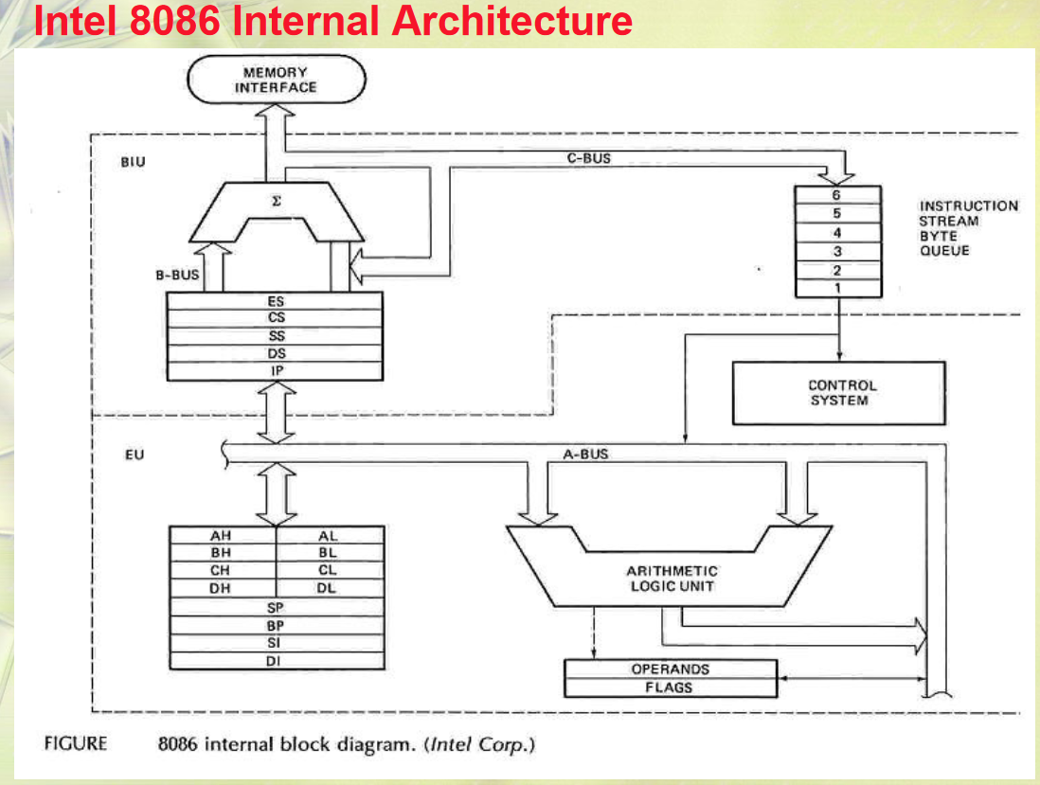

Slide 6
8086 is divided into 2 units
In order to increase execution speed and fetching speed, 8086 segments the memory.
Its 20-bit address bus can address 1MB of memory, it segments it into 16 64kB segments.
The internal architecture of Intel 8086 is divided into 2 units:
The Bus Interface Unit (BIU), and The Execution Unit (EU).
These are explained as following below.

Slide 7
1.Bus Interface Unit (BIU)
The segment registers, instruction pointer and 6-byte instruction queue are associated with the bus interface unit (BIU).
The BIU:
It generates the 20-bit physical address for memory access.
Handles transfer of data and addresses,
Fetches instruction codes, stores fetched instruction codes in first-in-first-out register set called a queue,
Reads data from memory and I/O devices, Writes data to memory and I/O devices,
Maintains the 6-byte pre-fetch instruction queue(supports pipelining).
It relocates addresses of operands since it gets un-relocated operand addresses from EU.
The EU tells the BIU from where to fetch instructions or where to read data.

Slide 8
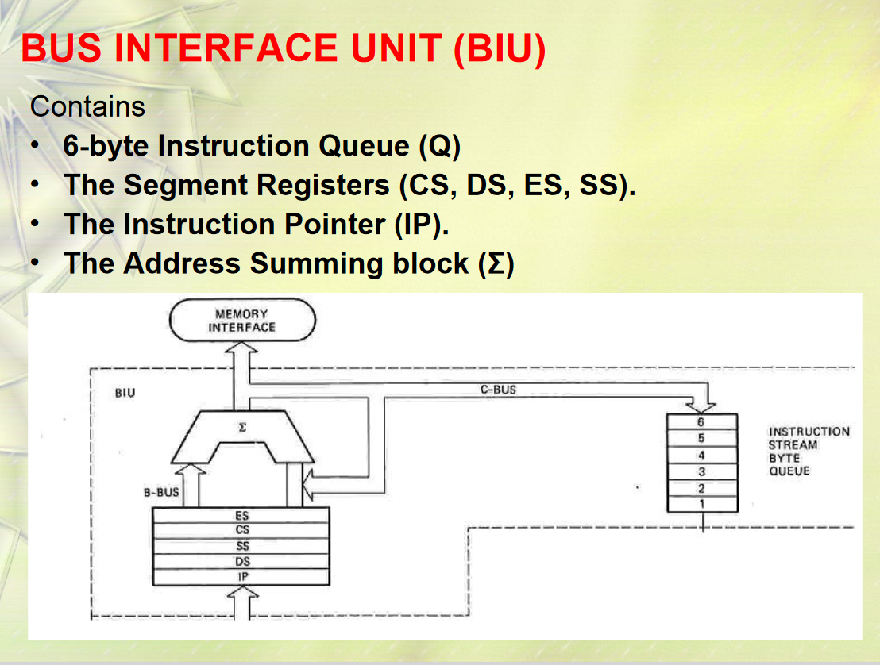

Slide 9
It has the following functional parts:
1.Segment Registers: A segment register contains the addresses of instructions and data in memory which are used by the processor to access memory locations.
It points to the starting address of a memory segment currently being used. There are 4 segment registers in 8086 as given below:
Extra Segment Register (ES): Extra segment holds the destination addresses of some data of certain string instructions.
Code Segment Register (CS): Code segment of the memory holds instruction codes of a program.
Stack Segment Register (SS): Stack segment holds addresses and data of subroutines. It also holds the contents of registers and memory locations given in PUSH instruction.
Data Segment Register (DS): The data, variables and constants given in the program are held in the data segment of the memory.

Slide 10
Instruction Pointer (IP): The instruction pointer in the 8086 microprocessor acts as a program counter.
It indicates to the address of the next instruction to be executed.
It is a 16-bit register. It holds offset of the next instructions in the Code Segment.
IP is incremented after every instruction byte is fetched.
IP gets a new value whenever a branch instruction occurs.
CS is multiplied by 10H to give the 20-bit physical address of the Code Segment.
The address of the next instruction is calculated by using the formula CS x 10H + IP.

Slide 11
-Address Summing Block
The Σ symbol is responsible for the calculation unit which is used to calculate the physical address of an instruction in memory.

Slide 12
Instruction Queue: When EU executes instructions, the BIU gets 6-bytes of the next instruction and stores them in the instruction queue and this process is known as instruction pre fetch.
This process increases the speed of the processor.
Prefetch unit:
The Prefetch Unit in the 8086 microprocessor is a component responsible for fetching instructions from memory and storing them in a queue.
The prefetch unit allows the 8086 to perform multiple instruction fetches in parallel, improving the overall performance of the microprocessor.
The prefetch unit consists of a buffer and a program counter that are used to fetch instructions from memory.
The buffer stores the instructions that have been fetched and the program counter keeps track of the memory location of the next instruction to be fetched.
The prefetch unit fetches several instructions ahead of the current instruction, allowing the 8086 to execute instructions from the buffer rather than from memory.

Slide 13
This parallel processing of instruction fetches helps to reduce the wait time for memory access, as the 8086 can continue to execute instructions from the buffer while it waits for memory access to complete.
This results in improved overall performance, as the 8086 is able to execute more instructions in a given amount of time.
The prefetch unit is an important component of the 8086 microprocessor, as it allows the microprocessor to work more efficiently and perform more instructions in a given amount of time.
This improved performance helps to ensure that the 8086 remains competitive in its performance and capabilities, even as technology continues to advance.

Slide 14
2.control unit :
The Control Unit in the 8086 microprocessor is a component that manages the overall operation of the microprocessor.
The control unit is responsible for controlling the flow of instructions through the microprocessor and coordinating the activities of the other components, including the Decode Unit, Execution Unit, and Prefetch Unit.
The Control Unit acts as the central coordinator for the microprocessor, directing the flow of data and instructions and ensuring that the microprocessor operates correctly.
It also monitors the state of the microprocessor, ensuring that the correct sequence of operations is followed.
The Control Unit is responsible for fetching instructions from memory, decoding them, executing them, and updating the microprocessor’s state.
It also handles interrupt requests and performs system management tasks, such as power management and error handling.

Slide 15
The Control Unit is an essential component of the 8086 microprocessor, as it allows the microprocessor to operate efficiently and accurately.
The control unit ensures that the microprocessor can execute complex instructions, such as jump instructions and loop instructions, by coordinating the activities of the other components.
The Control Unit helps to improve the performance of the 8086 microprocessor by managing the flow of instructions and data through the microprocessor, ensuring that the microprocessor operates correctly and efficiently.
This improved performance helps to ensure that the 8086 remains competitive in its performance and capabilities, even as technology continues to advance.

Slide 16
Decode unit:
The Decode Unit in the 8086 microprocessor is a component that decodes the instructions that have been fetched from memory.
The decode unit takes the machine code instructions and translates them into micro-operations that can be executed by the microprocessor’s execution unit.
The Decode Unit works in parallel with the Prefetch Unit, which fetches instructions from memory and stores them in a queue.
The Decode Unit reads the instructions from the queue and translates them into micro-operations that can be executed by the microprocessor.
The Decode Unit is an important component of the 8086 microprocessor, as it allows the microprocessor to execute instructions efficiently and accurately.

Slide 17
The decode unit ensures that the microprocessor can execute complex instructions, such as jump instructions and loop instructions, by translating them into a series of simple micro-operations.
The Decode Unit is responsible for decoding instructions, performing register-to-register operations, and performing memory-to-register operations.
It also decodes conditional jumps, calls, and returns, and performs data transfers between memory and registers.
The Decode Unit helps to improve the performance of the 8086 microprocessor by allowing it to execute instructions quickly and accurately.
This improved performance helps to ensure that the 8086 remains competitive in its performance and capabilities, even as technology continues to advance.

Slide 18
3. The Execution Unit (EU):
The main components of the EU are General purpose registers, the ALU, Special purpose registers, the Instruction Register and Instruction Decoder, and the Flag/Status Register.
Fetches instructions from the Queue in BIU, decodes, and executes arithmetic and logic operations using the ALU.
Sends control signals for internal data transfer operations within the microprocessor.(Control Unit)
Sends request signals to the BIU to access the external module.
It operates with respect to T-states (clock cycles) and not machine cycles.

Slide 19
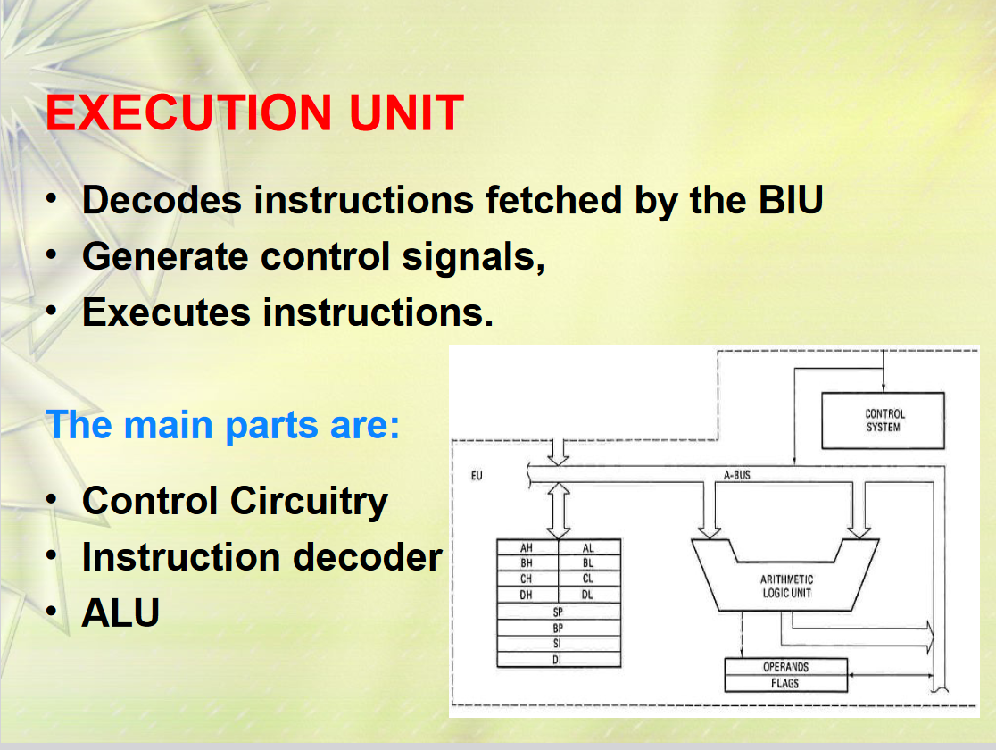

Slide 20
8086 has four 16-bit general purpose registers AX, BX, CX, and DX which store intermediate values during execution. Each of these has two 8-bit parts (higher and lower).
AX register: (Combination of A_{L} and A_{H} Registers) It holds operands and results during multiplication and division operations. Also an accumulator during String operations.
BX register: (Combination of B_{L} and B_{H} Registers) It holds the memory address (offset address) in indirect addressing modes.
CX register: (Combination of C_{L} and C_{H} Registers) It holds the count for instructions like a loop, rotates, shifts and string operations.
DX register: (Combination of D_{L} and D_{H} Registers) It is used with AX to hold 32-bit values during multiplication and division.

Slide 21
Special purpose registers (16-bit): Special purpose registers are called Offset registers also. Which points to specific memory locations under each segment.
We can understand the concept of segments as Textbook pages. Suppose there are 10 chapters in one textbook and each chapter takes exactly 100 pages. So the book will contain 1000 pages. Now suppose we want to access page number 575 from the book then 500 will be the segment base address which can be anything in the context of microprocessors like Code, Data, Stack, and Extra Segment. So 500 will be segment registers that are present in Bus Interface Unit (BIU). And 500 + 75 is called an offset register through which we can reach on specific page number under a specific segment.
Hence 500 is the segment base address and 75 is an offset address or (Instruction Pointer, Stack Pointer, Base Pointer, Source Index, Destination Index) any of the above according to their segment implementation.
Stack Pointer: Points to Stack top. Stack is in Stack Segment, used during instructions like PUSH, POP, CALL, RET etc.
Base Pointer: BP can hold the offset addresses of any location in the stack segment. It is used to access random locations of the stack.
Source Index: It holds offset address in Data Segment during string operations.
Destination Index: It holds offset address in Extra Segment during string operations.

Slide 22
Instruction Register and Instruction Decoder:
The EU fetches an opcode from the queue into the instruction register. The instruction decoder decodes it and sends the information to the control circuit for execution.
Flag/Status register (16 bits): It has 9 flags that help change or recognize the state of the microprocessor.
6 Status flags:
Carry flag(CF)
Parity flag(PF)
Auxiliary carry flag(AF)
Zero flag(Z)
Sign flag(S)
Overflow flag (O)
Status flags are updated after every arithmetic and logic operation.
3 Control flags:
Trap flag(TF)
Interrupt flag(IF)
Direction flag(DF)
These flags can be set or reset using control instructions like CLC, STC, CLD, STD, CLI, STI, etc. The Control flags are used to control certain operations.

